Slide 1



















A Primer on The NSF SecureCloud Project
Casimer DeCusatis, Ph.D.
Assistant Professor, Marist College @Dr_Casimer
HVCSC

Slide 2
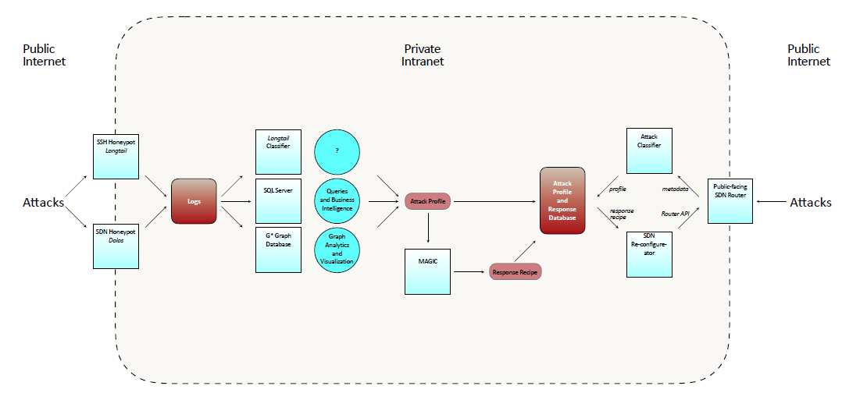
SecureCloud (thanks to Alan for the slide which prompted this exercise)

Slide 3
SecureCloud in 1 sentence
We are implementing a zero trust cloud computing network architecture
Why?
Conventional cybersecurity doesn’t work well for cloud computing, because you can’t easily draw a perimeter around the data you’re trying to protect
Well documented (by IBM, Cisco, Verizon, etc) that traditional methods are:
Too slow detecting attacks (some attacks go undetected for 6 months or more)
Too slow responding to attacks (manually provisioned when we need to automate)
Missing some types of attacks (DDoS Masking)
No way to establish trusted packets (NIST proposed zero trust in 2013, nobody has built one yet)
Software defined networks (SDN) and software defined data centers (SDDC) are disruptive technologies, enabling us to dramatically improve security

Slide 4
SecureCloud in 1 slide
Bad Actors scan our cloud network looking for exploits
Bad Actors don’t find the real SDN controller or SSH protected resources, since they are cloaked using BlackRidge
Instead, they find the SSH and SDN honeypots
We collect data on the attacks which will be processed to create actionable threat intelligence
Threat intelligence is used to implement or alter security policy for network devices (routers, firewalls, authentication appliances, etc)

Slide 5
What is Zero Trust?
A zero trust network:
Authenticates everything (even communication between 2 VMs on the same physical server); Eliminates the notion of a trusted and untrusted network (Trust nothing, verify everything)
Ensure all resources are accessed securely regardless of location - assume all traffic is a threat until it is authorized, inspected, and secured (Deny by Default)
Least Privilege approach such as Role Based Access Control
Allows only necessary data for a given application (segment, encrypt, lockdown)
Inspect and log all traffic via Network Analysis and Visibility (NAV) tools
Preferably has automated, fast response for attack detection/defense
Is easily managed and segmented at fine granularity (not just VLANs, and doesn’t significantly hold up data flow for authentication)
Delivers simplicity, scalability, portability, and data protection
Requires interactive approach between development, IT, & executive management

Slide 6
Zero Trust is currently a theoretical abstraction But, Disruptive Technologies may enable Zero Trust Networks
Authentication Gateways (packet based identity management)
Simplify & centralize management and segmentation
SDN with multi-layer network orchestration via open APIs
Collect data from multiple sources within and outside the network itself
Services are being deconstructed into micro-services (may require significantly more APIs)
Integrated segmentation gateways (vs perimeter only defense)
Implemented with next generation NFV virtual router/firewalls
Combined with SDN to create actionable threat intelligence
Remove silo management approach (including SDN MAN/WAN)
We use silos to reduce risk, and because we lack programmable, portable OSS/BSS software; but they are not desirable and don’t provide fine granularity or fast management control
Silos break down as we introduce service chaining & micro-services (service start/end points becomes vague)

Slide 7
SecureCloud in a bit more detail
Bad Actors scan our cloud network looking for exploits
May come from outside the network (as shown on slide) or insider threats (not explicitly shown)
May be brute force attack (exhaustive dictionary, DDoS) or hybrid/combination attack (DDoS masking other malware insertion)
Bad Actors don’t find the real SDN controller or SSH protected resources, since they are cloaked using BlackRidge
Instead, they find the SSH and SDN honeypots
Critical that we penetration test BlackRidge & validate their real world use cases such as HV Credit Union
We collect data on the attacks which will be processed to create actionable threat intelligence
The more data we collect, the better our defense – using the enemy’s strength against them
We’re dealing with a large number of attacks: over 120,000 per day against SSH & growing, so this is potentially a big data analysis problem
Number of SDN attacks is unknown since we’re the first ones to deploy an SDN honeypot to the best of our knowledge
Number of combination attacks is unknown since we currently have no way to detect them (one of the objective of SecureCloud is to address this)
Threat Intelligence is used to alter security policy
This involves static or dynamic re-provisioning of firewall access control lists, WAN bandwidth, and other parameters under control of software orchestration, OpenStack/VMWare ESXi, SDN controllers, APIs, etc.

Slide 8
Honeypots
Data which is collected from the honeypots includes:
SSH Honeypot: source IP address and port, target IP address and port, userid account and password attempted, time of day
An SSH attack pattern or attack signature is defined as: A list of accounts and passwords, from a single IP address, targeting a single IP address, which makes multiple attempts to break in, each attempt is within 180 seconds of the last attempt
An SSH botnet is defined as : a group of attack patterns which have the same MD5 checksum
SDN Honeypot: all of the SSH honeypot information, plus the attacking browser, ISP, AS, and geo-location coordinates
We can do attack pattern and botnet classification for SDN with the same data as for SSH
New definitions will be required which use the additional data to make better attack signatures and better botnet classifications (will require modification to LongTail)

Slide 9
Slight Digression…
How many signatures and botnets did you find?
How big are the botnets?
Why did you choose 180 seconds?
How do you implement geo-fencing?
Could we implement a fake network behind the honeypot to make the attacker stick around longer?
For the answers to these and many other common questions, see our draft LongTail paper or Eric’s presentation at Derbycon in 2015

Slide 10
Creating Threat Intelligence
Data collected from honeypots is stored in several ways
LongTail currently stores SSH and SDN data as flat files with specific formatting
Dolos (SDN honeypot) also stores data in either SysLog or SQL (which can be read into Gstar)
Attack patterns and botnets are stored in separate flat files (or elsewhere as needed)
LongTail helps us detect and classify attack patterns and botnets
Modified LongTail will hopefully help us do a better job of this and find new types of attacks such as DDoS masking malware attacks
Gstar will hopefully help us identify and detect more useful attack patterns
In the future, we might create an immutable BlockChain recording all changes in the system which can be mined for additional threat intelligence

Slide 11
What do we mean by analytics?
No standard definition; according to NSF, NIST, IBM, Wikipedia, and others, it goes something like this:
The systematic computational analysis of data and statistics, or information resulting from such analysis. This includes, but is not limited to, statistical analysis, frequency analysis, classification, anomaly detection, pattern recognition, and other means to extract useful insights from data sets. Analytics may produce historical trends, real time analysis, or predictive methodologies.
So…LongTail and Gstar are both forms of analytics…in the future perhaps Watson could do this as well
digression…I’d like to train Watson to pass an industry cybersecurity certification exam, so we can use it as an expert advisor…end digression
digression 2…IBM wants to run Spark on Z, maybe we do something with our LongTail data…end digression 2

Slide 12
What can we do with Gstar?
Most attacks go undetected
For 6 months or more
Force graphs & hive plots visualizing LongTail data for SSH & Dolos
Graph database definition of attack pattern for DDoS Masking
Novel time dependent database; show me the evolution of an attack graphically
Find a botnet attack which coincides with a malware insertion attack (can’t do this today)
Possible anomaly detection, top/bottom analysis, or ??
Service Chaining
Similar to supply chain analysis; a server connects to a bunch of routers, a firewall, load balancer, etc and eventually to another computer; only some devices can be part of the chain based on security requirements (encryption level supported, etc)…what is the impact of one element in the chain being compromised?
Switch to another non-compromised service chain (Gstar tells me which ones are valid)
Tell me the impact if one chain element gets infected; who’s adjacent to it and how do I quarantine it (malware will try to infect adjacent devices, i.e. lateral spreading, so if Gstar tells me what to do I can program the rest of the network to isolate infected nodes and stop lateral spreading (making the entire SDN network act like a big honeypot in some sense).
Note: spinning up service chains on demand for a limited time application leads to so-called micro-services, which are a hot topic right now
Maybe other stuff (like energy efficient computing strategies ?)

Slide 13
How do I act on threat intelligence?
Manual configuration is too slow for modern attacks
Network devices (routers, firewalls, etc) must have APIs that allow me to configure them via software, instead of doing it manually we need to automate this process
2 kinds of configuration:
Static: tell everything in the service chain how to set its parameters based on the application security policy (banking will have different requirements than video games)
Dynamic: reconfigure devices in near real time, in response to attacks (botnet A is attacking, adopt security policy omega in response)
Both types require configuration of the software stack at different layers (which is why it’s called multi-layer) and across different SDN controller domains (which is why it’s called multi-domain)
We define 4 layers in our software stack as shown on the following slide:

Slide 14








Cloud Orchestration
Tried IBM ICO/ICM, moving to industry standard Heat API which should be compatible with everything
Tried OpenStack with Brocade/Vyatta 5600 (which would have been compatible with Brocade Virtual Traffic Manager).
Planning to write our own virtual firewall based on open source
May adopt VMWare ESXi to control devices
What type of controllers?
We tested all of them, focus currently on Open Daylight, might consider vendor options
What type of devices?
Brocade/Vyatta 5600 (API doesn’t work for OpenStack)
Ciena metro Ethernet (1Q 2017)
Cisco (we don’t have recent enough hardware to support API)
Juniper (in discussion)
BlackRidge (4Q 2016 API support, 3Q 2017 SDN)
Application Management Layer
Firewall IDS/IPS
Load Balancing
Content Delivery
Other Application
Policy Management API
Security & Authentication
Services Management Layer
Configuration
Congress
Nova
Neutron
Cinder
Compute
Network
storage
drivers
drivers
drivers
Zone Controller
Hypervisor
Platforms
Storage
Virtualization Platforms
Adaptation Layer
Virtual
Overlay Control Plane
Physical
Flow Control
Plane
Virtual
Overlay Control Plane
Physical
Flow Control
Plane
Forwarding Layer
Servers
Network
Zone 1
Network
Zone 2
Storage

Slide 15
Getting into more technical detail…
We collect raw data from our honeypots (and potentially other sources)
We process this data to create actionable threat intelligence
Definition of threat intelligence is on the following slide
We would like to measure latency and response time once we get a dynamic policy system working
How fast can we identify and respond to a given attack vs traditional manual methods…there are multiple dynamic provisioning paths and feedback loops in our control system, analogous to the OODA model in the following slides
Don’t freak out over the following couple of slides…

Slide 16
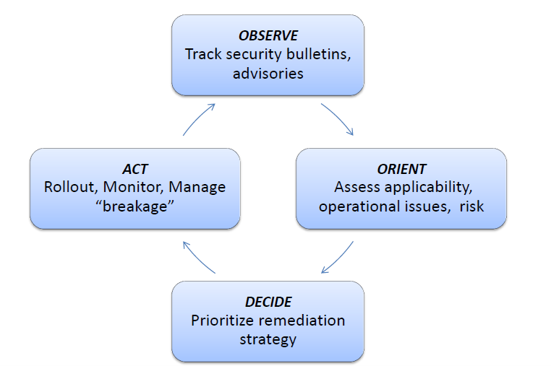
Threat Intelligence: Data that has been analyzed to render it relevant, actionable, and valuable
J. Boyd, “The OODA Loop,” Feb 2010. [Online]. Available: http://www.danford.net/boyd/essence4.htm . [Accessed 13 Feb 2014]
NIST Computer Security Resource Center, T. Sager, Center for Internet Security, Arlington, VA http://csrc.nist.gov/news_events/cif_2015/security-automation/day3_security-automation_930-1020.pdf

Slide 17
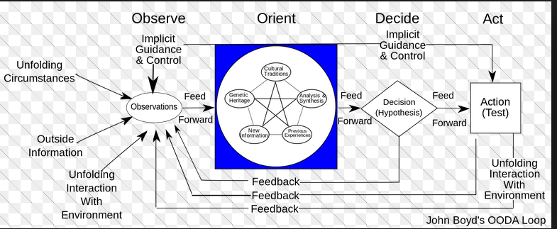
Boyd’s OODA model
Analogous to the Deming cycle (PDCA) or IBM Design Thinking model
We might Observe via honeypot data collection, Orient & Decide via LongTail, Act via 4 layer stack (this is still a work in progress…)

Slide 18
Novel Features of SecureCloud
First known creation/deployment of SDN honeypot in the wild (Marist Syracuse data center)
Longtail (which was selected for the IEEE Try-CybSi cybersecurity project) is perhaps the first and only tool to perform all 5 levels of attack analysis shown below (before we modify it to handle Dolos data):
Where are the attacks coming from?
What accounts are being tried?
What passwords are being tried & what account/PW pairs are prevalent
What attack patterns are there?
What botnets are out there?
Among first deployments/penetration tests for first packet authentication/transport access control using vendor neutral appliance (BlackRidge)
Among first attempts to dynamically orchestrate security policy (IEEE & others regularly hold conferences on SDN orchestration, still an emerging field)
Potentially first deployment of Gstar dynamic function graphs for cybersecurity analytics If you know of someone else doing similar work, please send me a technical reference; I’ve had too many people make offhand comments like “I saw that working somewhere” including our recent experiences with IBM ICO/ICM, Brocade/Vyatta 5600, etc.

Slide 19
What do we need to deliver to the NSF and When?
Task 1 - Mitigation of multi-component malware infiltration
(A) DDoS mitigation, static use case (August 2016)
(B) DDoS detection/mitigation, dynamic (October 2016)
(C ) DDoS masking attacks / security policy orchestration (January 2017)
(D) Production test/implementation in Marist cloud (January 2018)
•Task 2 - Traffic visibility using segmentation & service chaining
(A) Slicing or secure segmentation of an SDN network (July 2016)
(B) Traffic segregation based on bandwidth, flow type (October 2016)
(C )Quarantine using function graphs for service chaining (March 2017)
(D) Production test/implementation in Marist network (January 2018)

Slide 20
How are we doing (August 2016)
BlackRidge penetration testing & Dolos honeypot are doing well, off to a good start
We are a bit behind schedule on static security policy deployment (Graham's project to push commands from OpenStack down to the Brocade 5600). Starting this fall we hope to hire Liam to write a new firewall from scratch based on open source code (target complete ??)
Willing to consider using VMWare/ESXi instead of OpenStack if that helps ?
Dynamic policy deployment should follow fairly quickly after static (using LongTail classifier or similar approach) once we establish a connection to the 5600 or similar. For this we need the SDN controller honeypot, Dolos (which is ready) and a way to cloak the real controller (BlackRidge, which is also ready). We may need students to help update LongTail with Eric leaving.
Masking attacks (inserting malware under cover of a DDoS attack) gets back to either hive plots or anomaly detection/time evolution graphs for GStar; we are also a bit behind here, reassigning Graham should help.
Pre-production testing for both tasks is a separate issue and comes later. Sufficient to say that BlackRidge is planned for production use in the Marist LinuxOne cloud, Dolos is being deployed at our Syracuse data center, and I'm not too concerned about showing some results in this area over the next 2 years.
Bandwidth slicing was originally conceived as a follow-on to the Adva work, but since both Adva & Ciena are not contributing much as this point (Ciena has pushed out Blue Planet to 1Q 2017) I'm implementing this with BlackRidge. Traffic segmentation can be done via BlackRidge application firewalls (release 3.0, available now). So these projects aren't in bad shape for now.
Service chaining requires GStar features, which should enable us to halt lateral spread of viruses and quarantine infected systems. Again, we have some time to do this but are getting a slow start.

Slide 21
SecureCloud slide with updates
SDN Controller, SSH resources
Actually within the cloud, data border isn’t well defined as this text illustrates
Cloaked by BlackRidge
Orchestrator Mddleware
OVS/ODL
Magic
Science
Analytics Math!

Slide 22
Major Papers/Presentations
BlackRidge & LongTail pen testing work to date (in press)
IEEE MIT student conference (due Sept 3, 2016)
Dolos honeypot (Vallie, Tien, others ?)
BlackRidge penetration testing (Tien, Vallie, others…may not be ready for this conference)
IBM TechConnect (due Sept 14 ?)
2 posters, half the students on each one ?
IEEE fall workshop (November 10 ?)
BlackRidge paper #2; features in 3.0 (application firewall, rogue router scenario for NTP) and 3.1 (API control) – TBD
NFV orchestration paper (when we get it working)
Dolos paper (with data from Syracuse & updated Longtail)
Gstar paper (all the stuff on the Gstar slide)
Women’s technical conference (RIT, Spring 2016): Michelle, Vallie
IBM Edge (Sept 2017)

Slide 23

Questions/Comments always welcome

